Slide 1

Credit Loan and Interest Rate Prediction Presented By: Saurabh Zulkanthiwar

Slide 2
Introduction
What is Credit Loan Data
Dataset Preview
Features
Data Collection

Slide 3
Problem Statement
The purpose of this project is to develop a multiclass classification model for Credit Loan Data using features such as Credit Score, Term, Income and others.
To achieve this objective, we will utilize various machine learning techniques including decision trees, random forests, gradient boosting machines (GBMs), XGBoost, and Logistic regression. The goal is to identify the most accurate and robust model for the prediction task

Slide 4
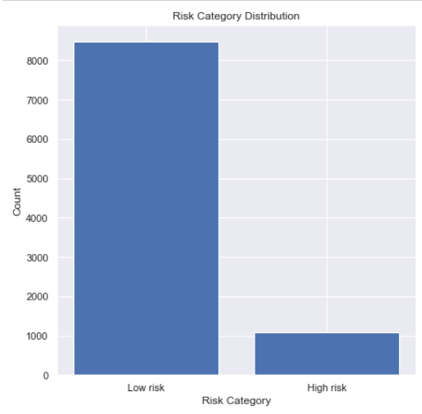
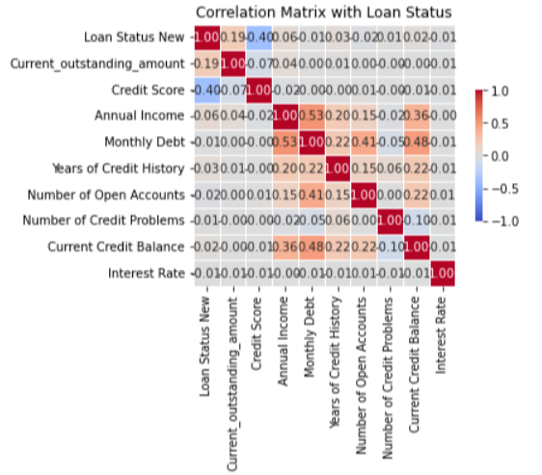
Exploratory Data Analysis

Slide 5
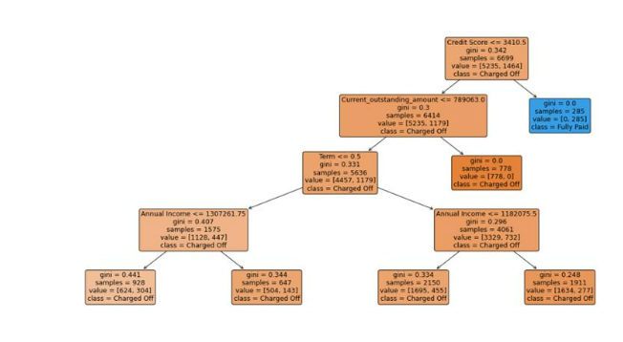
Decision Tree Classification

Slide 6
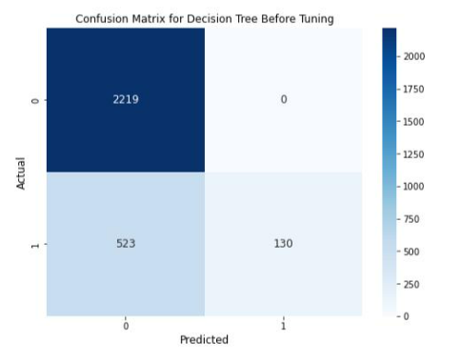
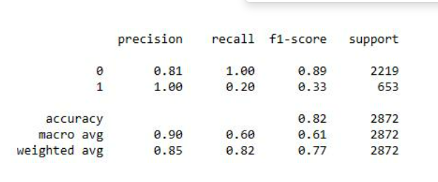
Decision Tree Model Performance Before Tuning

Slide 7
Feature Engineering
Performed One Hot Encoding on Loan Status :
Success = 1 ; Failure = 0
Parameters:
Loan Status
Current Outstanding Amount
Credit Score
Annual Income
Monthly Debt
Years of Credit History

Slide 8
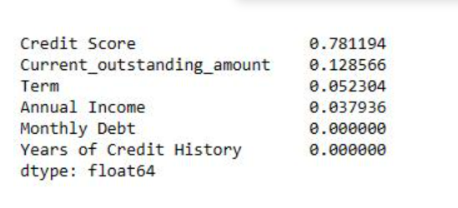
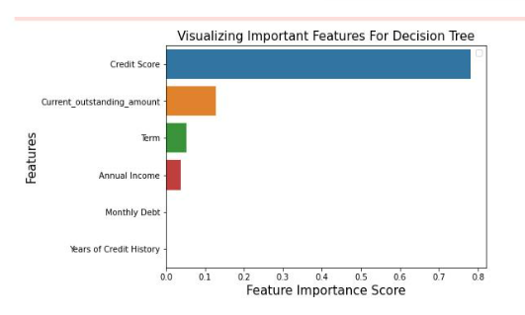
Feature Selection

Slide 9
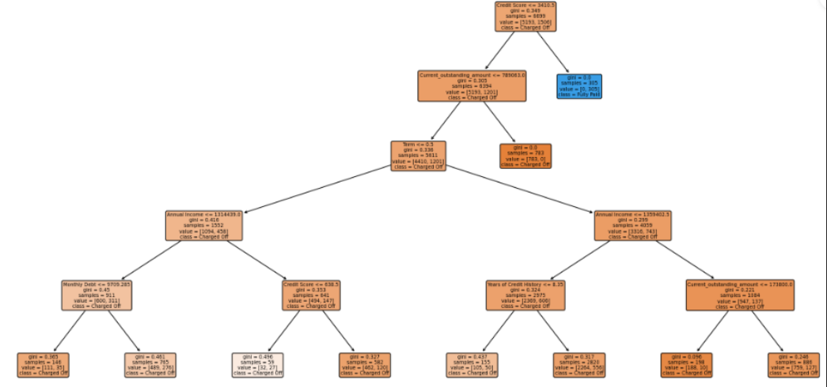
Decision Tree Classification After Tuning

Slide 10
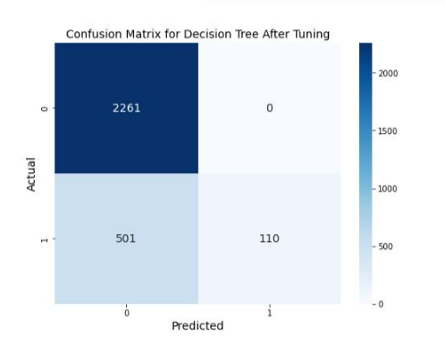
Model Performance After Tuning

Slide 11
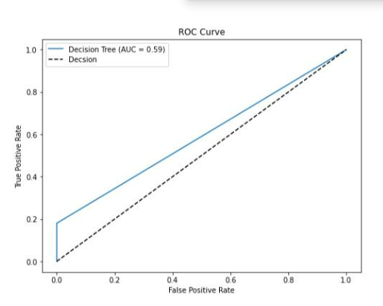
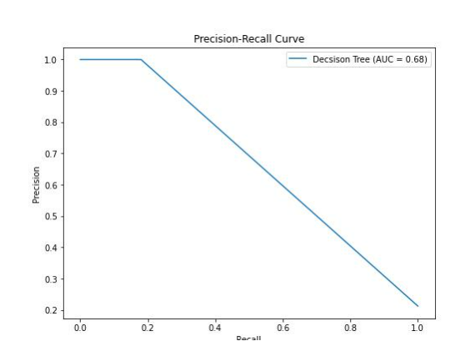
ROC Plot and Precision Recall Curve

Slide 12
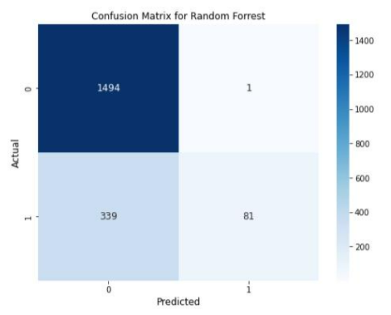
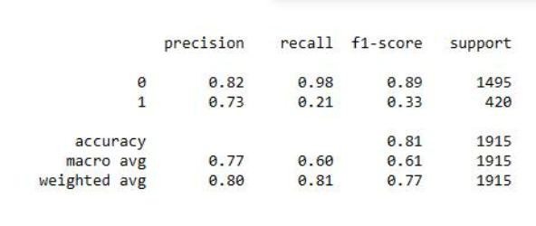
Model Performance Before Tuning
Random Forest Classification

Slide 13
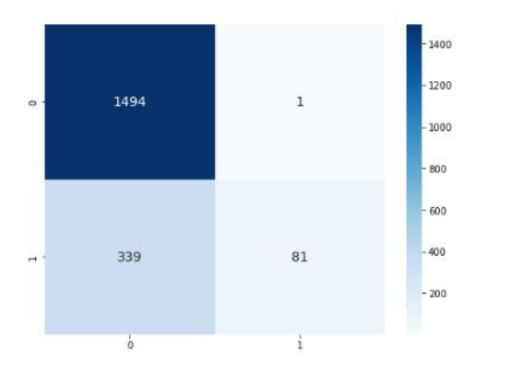
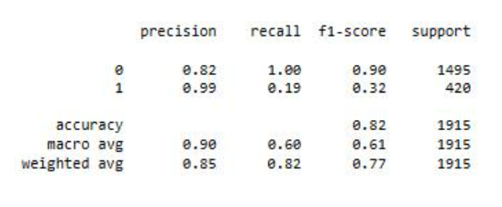
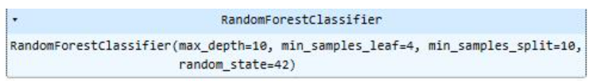
Optimized Model

Slide 14
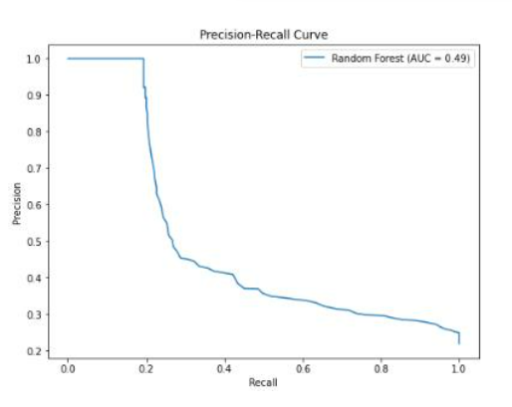
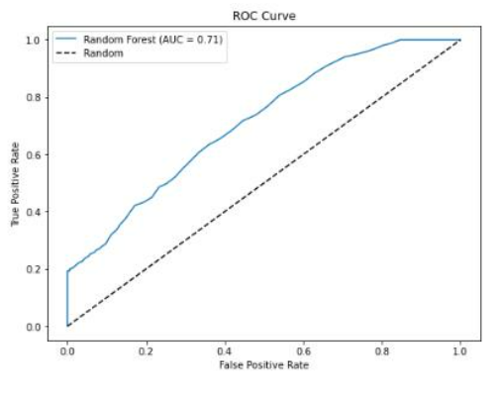
ROC Plot and Precision Recall Curve

Slide 15
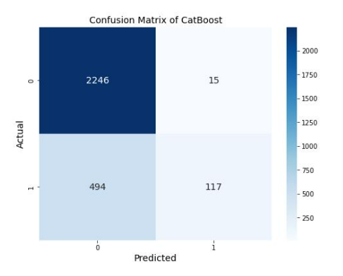
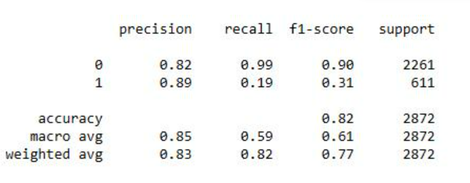
Boosting Methodologies – CATBoost

Slide 16
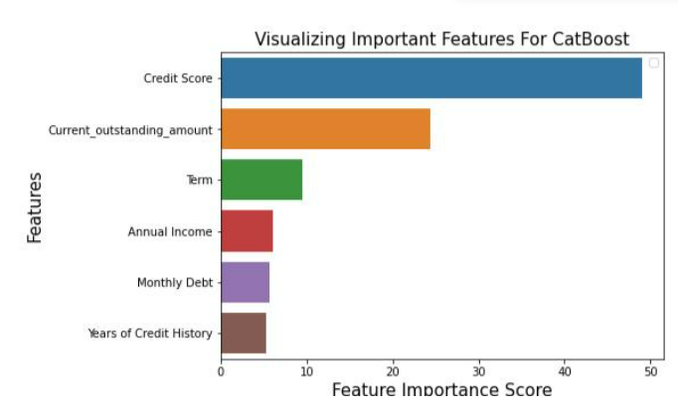
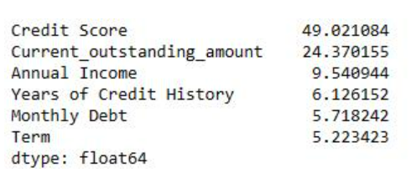
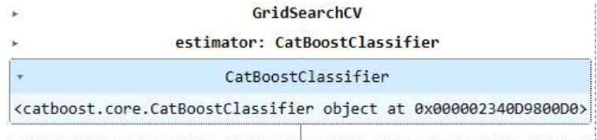
CATBoost Feature Importance

Slide 17
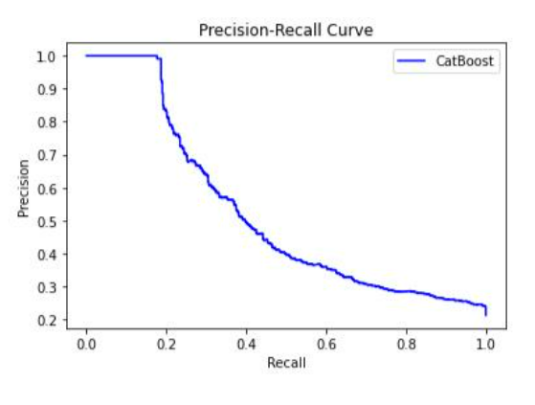
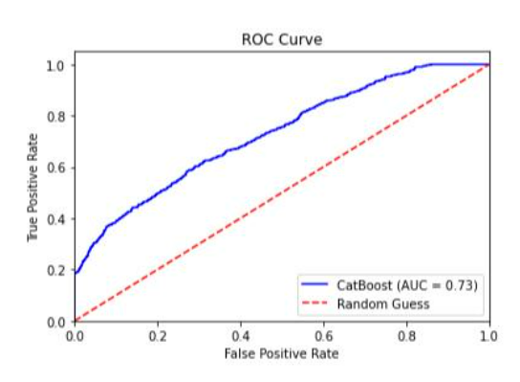
ROC Plot and Precision Recall Curve
AUC=0.57

Slide 18
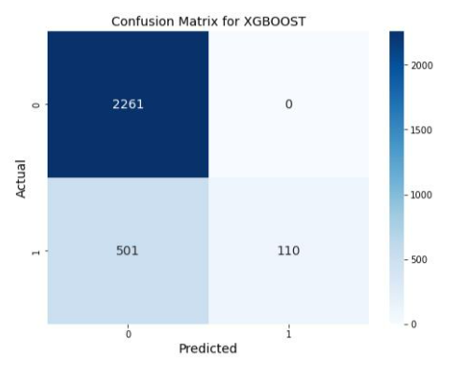
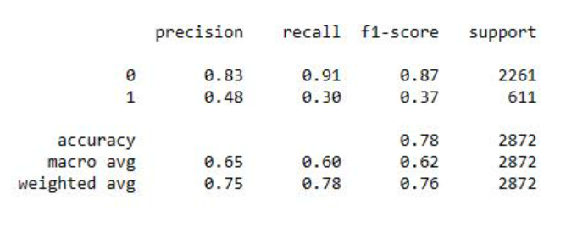
Boosting Methodologies – XGBoost

Slide 19
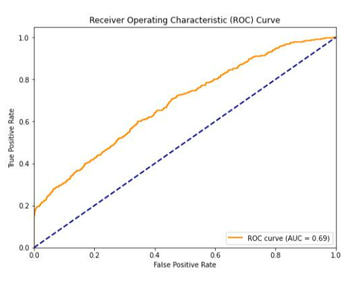
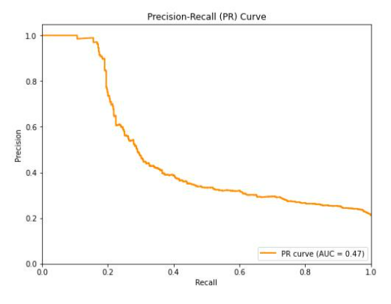
ROC Plot and Precision Recall Curve

Slide 20
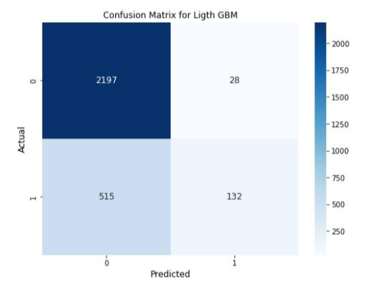
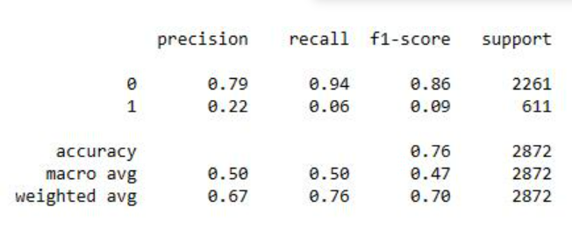
Boosting Methodologies – LightGBM

Slide 21
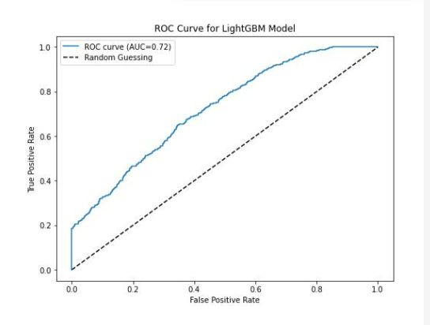
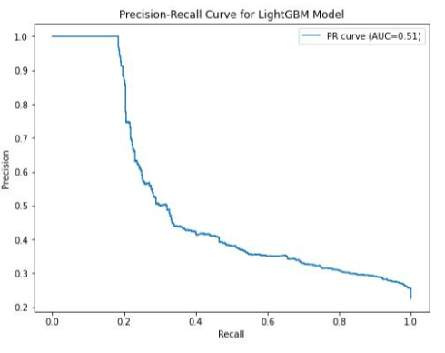
ROC Plot and Precision Recall Curve

Slide 22
Model Comparison
Decision Tree
Random Forest

Slide 23
Decision Tree vs CATBoost
Decision Tree
CATBoost
AUC=0.57

Slide 24
Decision Tree vs XG Boost
Decision Tree
XG Boost

Slide 25
Decision Tree vs Light GBM
Decision Tree
Ligth GBM

Slide 26
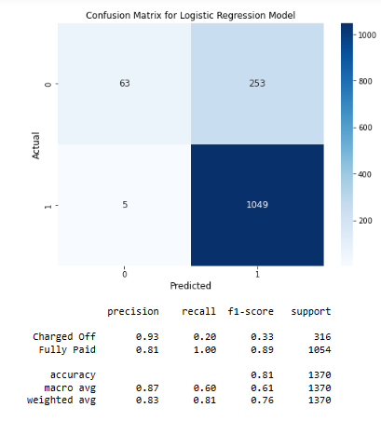
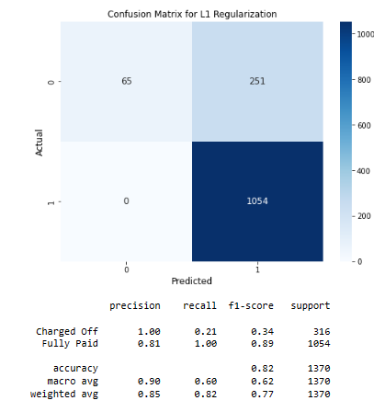
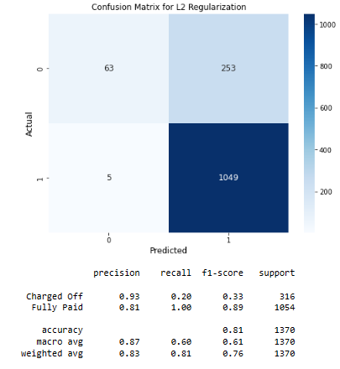
Logistic Regression Model
L 1 Regulation Model
L 2 Regulation Model

Slide 27
Conclusion
Upon assessment, it was determined that Decision Tree had the highest accuracy
Stakeholders can use this model to predict the success or failure of a with an expected accuracy of 83%.

Slide 28
References
Bluman, A. (2018). Elementary statistics. Mcgraw-hill Education.
Decision Tree. (2023). Retrieved 29 March 2023, from https://www.mastersindatascience.org/learning/machine-learning-algorithms/decision-tree/
Garg, R. (2018). A Primer to Ensemble Learning – Bagging and Boosting . Retrieved 29 March 2023, from https://analyticsindiamag.com/primer-ensemble-learning-bagging-boosting/

Slide 29
THANK YOU

